Slide 1

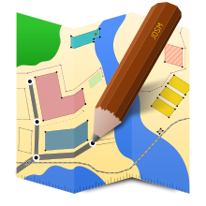



Open Street Map Let’s Peel Back the OSM Layers
Monday 4/8/2019 Workshop – 1:00 – 5:00 pm
By Marshall Wilson Ballard, GISP Transportation Informatics Architect
Associate Fehr & Peers
@marsxul

Slide 2
Workshop Outline
What is Open Street Map
State of the Map
Open means what?
Stretch
Your account and OSM Wiki
Geometries OSM style
Tags
Stretch
Editing
Common Uses
Basemap and More Extracting Data
Applied Uses
Let’s go for a walk

Slide 3
Special Thanks
Christina Boggs – NorCal GIS URISA All-Star
Randal Hale – Georgia URISA All-Star
They previously taught an OSM workshop at the 2014 CalGIS Conference
Slides with an * are recycled from their presentation – Give Credit when due

Slide 4



Open Street Map
History
Contemporary
Conferences
Humanitarian
Help

Slide 5
Grassroots Community approach *
Fight the power of the Royal authority of British national mapping
Donated GPS tracks around London from Ecourier bicycle track data
Mapping parties began in 2005 Limehouse Town Hall
Who has attended or hosted a mapping party?
Who has never attended a mapping party?
Volunteers map disaster zones, Haiti’s 7.0 magnitude Earthquake in 2010
Share your knowledge and Geographic passion with others

Slide 6


State of The Map – World and US
Worldwide conference to present and advocate Open Street Map
General and Technical resources
Latest applications and newest technologies leveraging OSM
2019 – Hedelburg, Germany
https://2019.stateofthemap.org/
SOTMUS – Minneapolis
https://2019.stateofthemap.us/
Notes:
Our motto: Bridging the Map
Right next to the old bridge in Heidelberg there lives a curious little statue – a bronze monkey. In its hand, it holds a mirror to remind anyone crossing the bridge to look back from where they came from and remember who they are. For the 2019 SotM in Heidelberg we want to take the role of that little monkey and remind everyone that no matter where we are going and what we are doing with OSM, we should never forget that we all come from the same origin: a little map that anyone can modify and use. Whether you are a hobby mapper, a scientific researcher, a humanitarian, an NGO, a government agency, a small business or a global company — we want to bridge the gap between us, or better yet, we want to Bridge the Map.

Slide 7

Humanitarian Open Street Map
https://www.hotosm.org/
Tasking Manger
Notes:
163,050
Community Mappersⓘ
46,356,112
Total Map Editsⓘ
38,713,388
Buildings Mappedⓘ
987,713
Roads Mapped (KM)ⓘ

Slide 8
Open means What?
Open Data
Open Source
Open Use
Contributions
API

Slide 9
ODBL after September 2012 to Present *
OpenStreetMap is open data, licensed under the Open Data Commons Open Database License (ODBL).
You are free to copy, distribute, transmit and adapt our data, as long as you credit OpenStreetMap and its contributors. If you alter or build upon our data, you may distribute the result only under the same license. The full legal code explains your rights and responsibilities.
http://opendatacommons.org/licenses/odbl/

Slide 10
So what does this licensing mean to you? *
If you download it and use it - your contributions/alterations must be contributed back to the author.
Any edits made to downloaded OSM data and made publically available need to be either added to OSM or made available to all.
https://wiki.osmfoundation.org/wiki/Licence

Slide 11
Help - https://www.openstreetmap.org/help
A
C
T
I
V
I
T
Y
OpenStreetMap has several resources for learning about the project, asking and answering questions, and collaboratively discussing and documenting mapping topics.
Welcome to OSM – Let’s review together
Start with this quick guide covering the OpenStreetMap basics.
Beginners' Guide – Who needs to create an account?
Community maintained guide for beginners.
help.openstreetmap.org
Ask a question or look up answers on OSM's question-and-answer site.
Mailing Lists
Ask a question or discuss interesting matters on a wide range of topical or regional mailing lists.
Forums
Questions and discussions for those that prefer a bulletin board style interface.
IRC
Interactive chat in many different languages and on many topics.
switch2osm
Help for companies and organisations switching to OpenStreetMap based maps and other services.
For Organizations
With an organization making plans for OpenStreetMap? Find what you need to know in the Welcome Mat.
wiki.openstreetmap.org
Browse the wiki for in-depth OSM documentation

Slide 12
Open an Account http://www.openstreetmap.com
A
C
T
I
V
I
T
Y
Create your account – Share your username with your new friends with your nametag
Read and accept the Contributor terms
Explore the Wiki - https://wiki.openstreetmap.org/wiki/Main_Page and tell us something about how your profession could contribute to OSM.
Notes:
Create your username and write it on your name tag and on our white board. Read and confirm the contributor terms, find an interesting fact in the wiki about your profession or how you want to apply OSM.

Slide 13
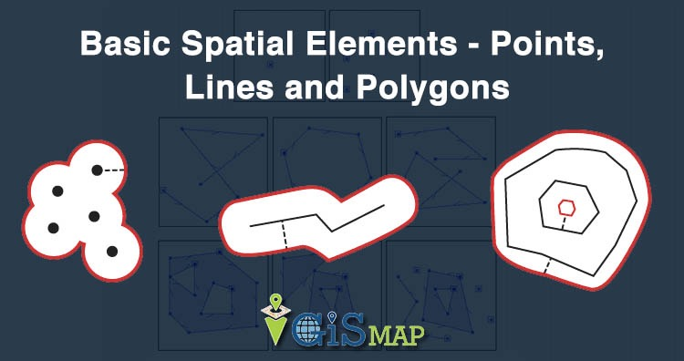



https://www.igismap.com/gis-tutorial-basic-spatial-elements-points-lines-and-polygons/
Geometries * Special Thanks To Randal and Christina
13

Slide 14
Points, Lines and Polygons – OSM Style a.k.a. Elements *
Nodes = Points; Ways = Lines and Polygons
Closed Ways can also be Areas
Relations describe logical or geographic relationships (think of multipoints or multipolygons or mmmmmm donuts)
Notes:
14
14
14
14

Slide 15
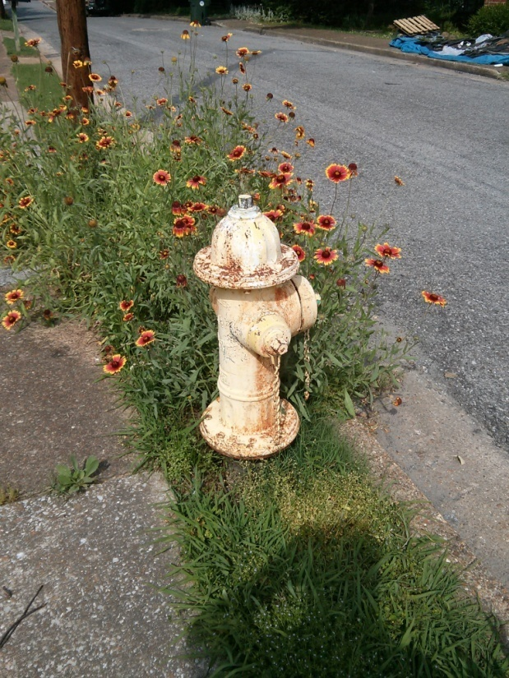
Nodes *
Single X and Y Coordinate
Things that would be a node:
Fire hydrant
Water fountain
Door/entrance
Pole
Sign
Tree

Slide 16
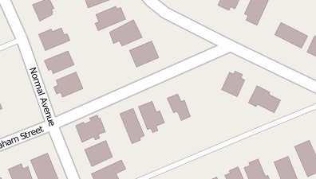
Way(s) *
Open Polyline(s)
Things that would be a way(s):
Stream(s)
Trail(s)
Road(s)
Railroad(s)
Subway(s)
Trolley route(s)
Notes:
16
16
16
16

Slide 17
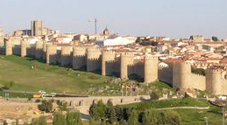
Way(s) *
Closed Way – 1st and last node are shared
Things that would be a closed way:
Some highways (bypass or loop)
Fence
Hedge
Typically these would have an area=yes tag*
*I know – “What’s a tag?” We’re getting there…

Slide 18
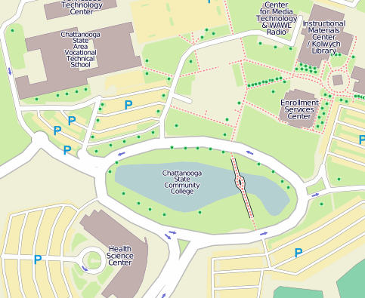
Way(s) Area *
Closed Way Tagged as Area
Things that would be an area:
Lake
Building
Park
Parking lot
Forested area
Notes:
18
18
18
18

Slide 19
Geometry Recap *
Two or more nodes that are connected form a way
A way that closes in on itself forms a closed way
A closed way can be an area (linear) or a building (polygon)
And all of that brings you to…

Slide 20
File Format *
XML File Format
<node id="25496583" lat="51.5173639" lon="-0.140043" version="1" changeset="203496" user="80n" uid="1238" visible="true" timestamp="2007-01-28T11:40:26Z">
<tag k="highway" v="traffic_signals"/>
</node>
Readable by:
ArcGIS http://www.esri.com
GDAL/OGR (Geospatial Data Abstraction Library) http://www.gdal.org
QGIS* http://www.qgis.org
PostGIS* http://www.postgis.org

Slide 21
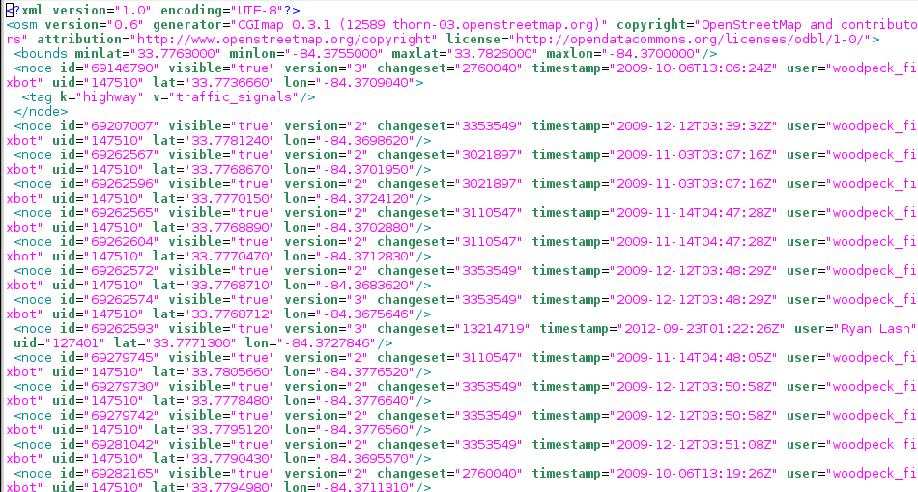
XML Data *
Notes:
21
21
21

Slide 22
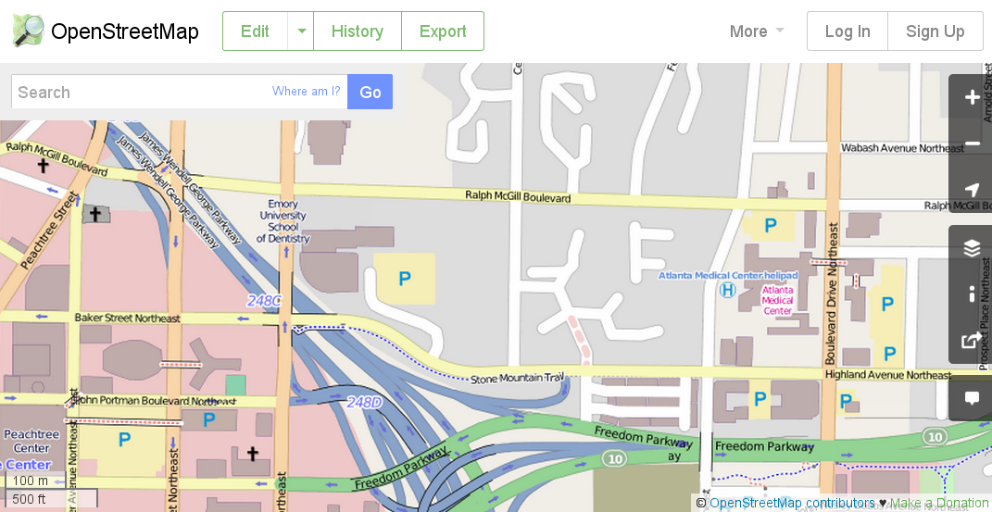
A Website*
Notes:
22
22
22

Slide 23
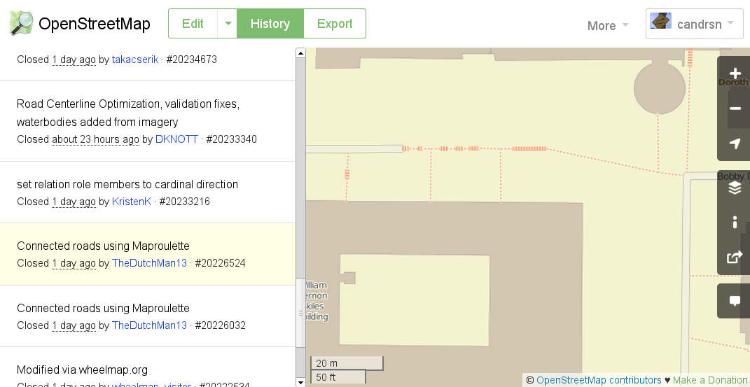
History of Edits*
Notes:
23
23
23

Slide 24

Exercise*
A
C
T
I
V
I
T
Y
Who is editing in your neighborhood
Click History
What are the people editing?
Click on each Changeset number.
What was changed?
Notes:
24
24
24
24

Slide 25
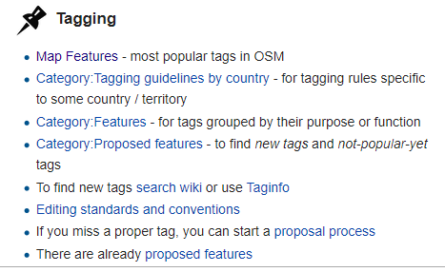
Tags What does it all mean?

Slide 26
Tags*
Tags are attributes
OpenStreetMap is feature rich
Also known as keys and values
As of 05/01/2013 there are:
41,221 different keys
59,593,881 different values or tags
Notes:
26
26
26
26

Slide 27
New Tag Creation*
Tags are vetted by the community
If you have something you want to add
Send email to tagging@openstreetmap.org
Subject line: “Feature Proposal – RFC – (Feature Name)”
Subject line: “Feature Proposal – Voting – (Feature Name)”
A rule of thumb for “enough support” is 8 unanimous approval votes or 15 total votes with a majority approval, but other factors may also be considered.
Notes:
27
27
27
27

Slide 28
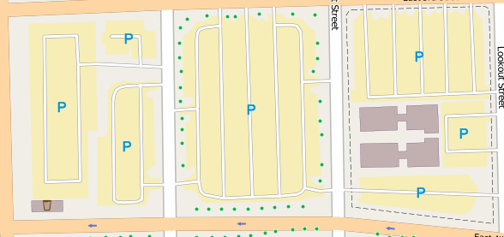
How do you know what to do? *
Preplan your edits if possible, then look up through the resources
Go here: http://wiki.openstreetmap.org
Example parking lots:
Geometry is a closed way
amenity = parking
Parking lanes can be highway = service
Notes:
28
28
28
28

Slide 29
Values are very British*
Highway: http://wiki.openstreetmap.org/wiki/Highway
highway = primary
Administrative classification in the UK, generally linking larger towns.
highway = secondary
Administrative classification in the UK, generally linking smaller towns and villages
highway = tertiary
A "C" road in the UK. Generally for use on roads wider than 4 metres (13') in width, and for faster/wider minor roads that aren't A or B roads. In the UK, they tend to have dashed lines down the middle, whereas unclassified roads don't.
highway = residential
Roads which are primarily lined with housing, but which are of a lowest classification than tertiary and which are not living streets. Using abutters=residential together with tertiary, secondary etc for more major roads which are lined with housing.
highway = path
A non-specific or shared-use path. Probably better to use highway=footway for paths mainly for walkers, highway=cycleway for one also usable by cyclists, highway=bridleway for ones available to horses as well as walkers and highway=track for ones which is passable by agriculture or similar vehicles.

Slide 30
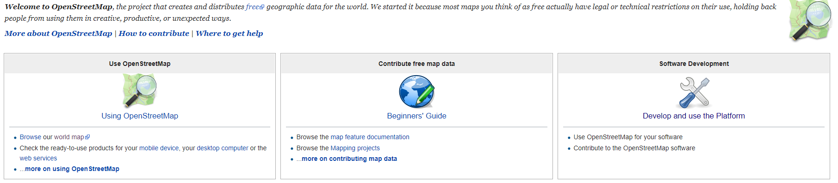
https://wiki.openstreetmap.org/wiki/Main_Page
The Wiki
https://wiki.openstreetmap.org/wiki/Map_Features#Transportation

Slide 31
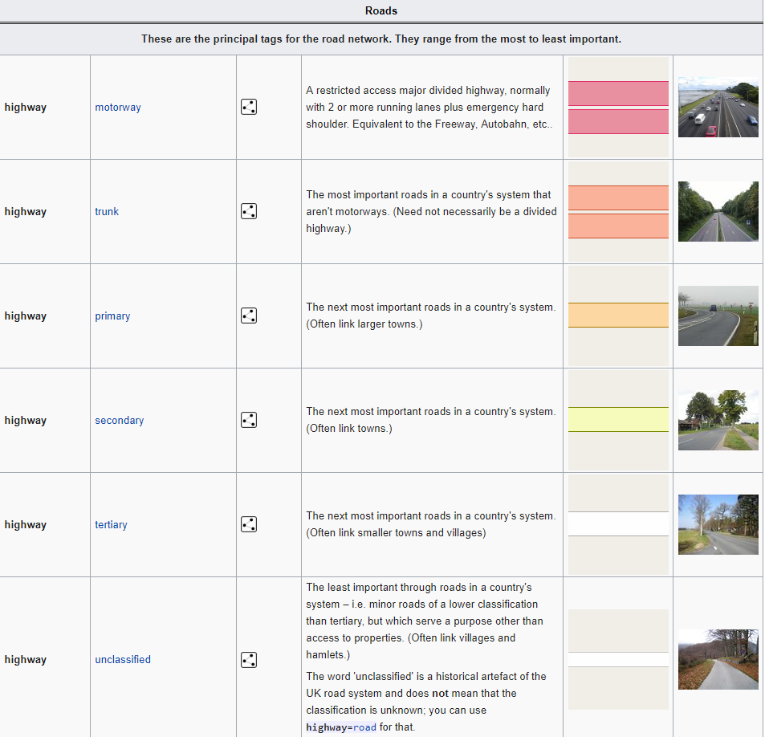
Wiki – Detailed Explanations* https://wiki.openstreetmap.org/wiki/Key:highway https://taginfo.openstreetmap.org/keys/highway#overview
Notes:
31
31
31

Slide 32
How you tag is up to you…
…mostly
You can be as detailed as you want
You can be as generic as you want
Something is better than nothing
Example:
amenity=cafe amenity=fast_food cuisine=* - for describing the ethnicity or type of the food served. diet=* - for describing dietary choices on offer such as vegetarian. brewery=* - Brewery, which beer is sold. opening_hours=* - for describing the opening hours. payment=* - for describing the payment methods accepted | website=* - for providing a link to a restaurant's website contact:website=* - another (less frequently used) way for providing a link to a restaurant's website. wheelchair=yes/no/limited - To indicate if the location is accessible with a wheelchair. drive_in=yes/no - To indicate if a restaurant offers drive-in service. See Drive-in for more information. takeaway=* - yes/no/only/seasonal. Does the amenity offer anything to take away.

Slide 33
Tags
A
C
T
I
V
I
T
Y
Research tags for an interesting idea
Investigate tags for items
https://taginfo.openstreetmap.org/tags

Slide 34
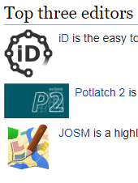
Editing Putting your hard earned GIS skills to practice
https://wiki.openstreetmap.org/wiki/Editors

Slide 35
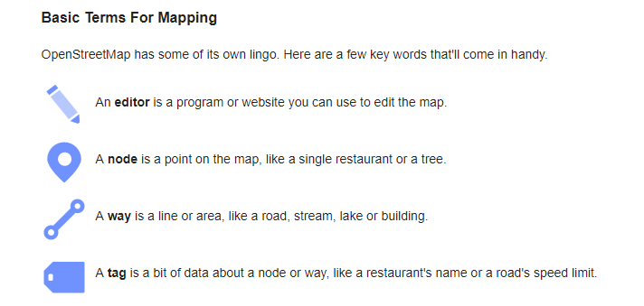
Editors
iD – in-browser editor – my preferred
Potlach 2 (in-browser editor)
Remote – JOSM or Merkaartor
Remember These

Slide 36
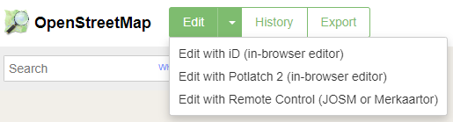
Editing with iD
Works best in Chrome and Firefox
Login – then select from dropdown menu
You can search on content, locations,
You can select items to edit
You can create new from scratch
Don’t forget to include tags

Slide 37
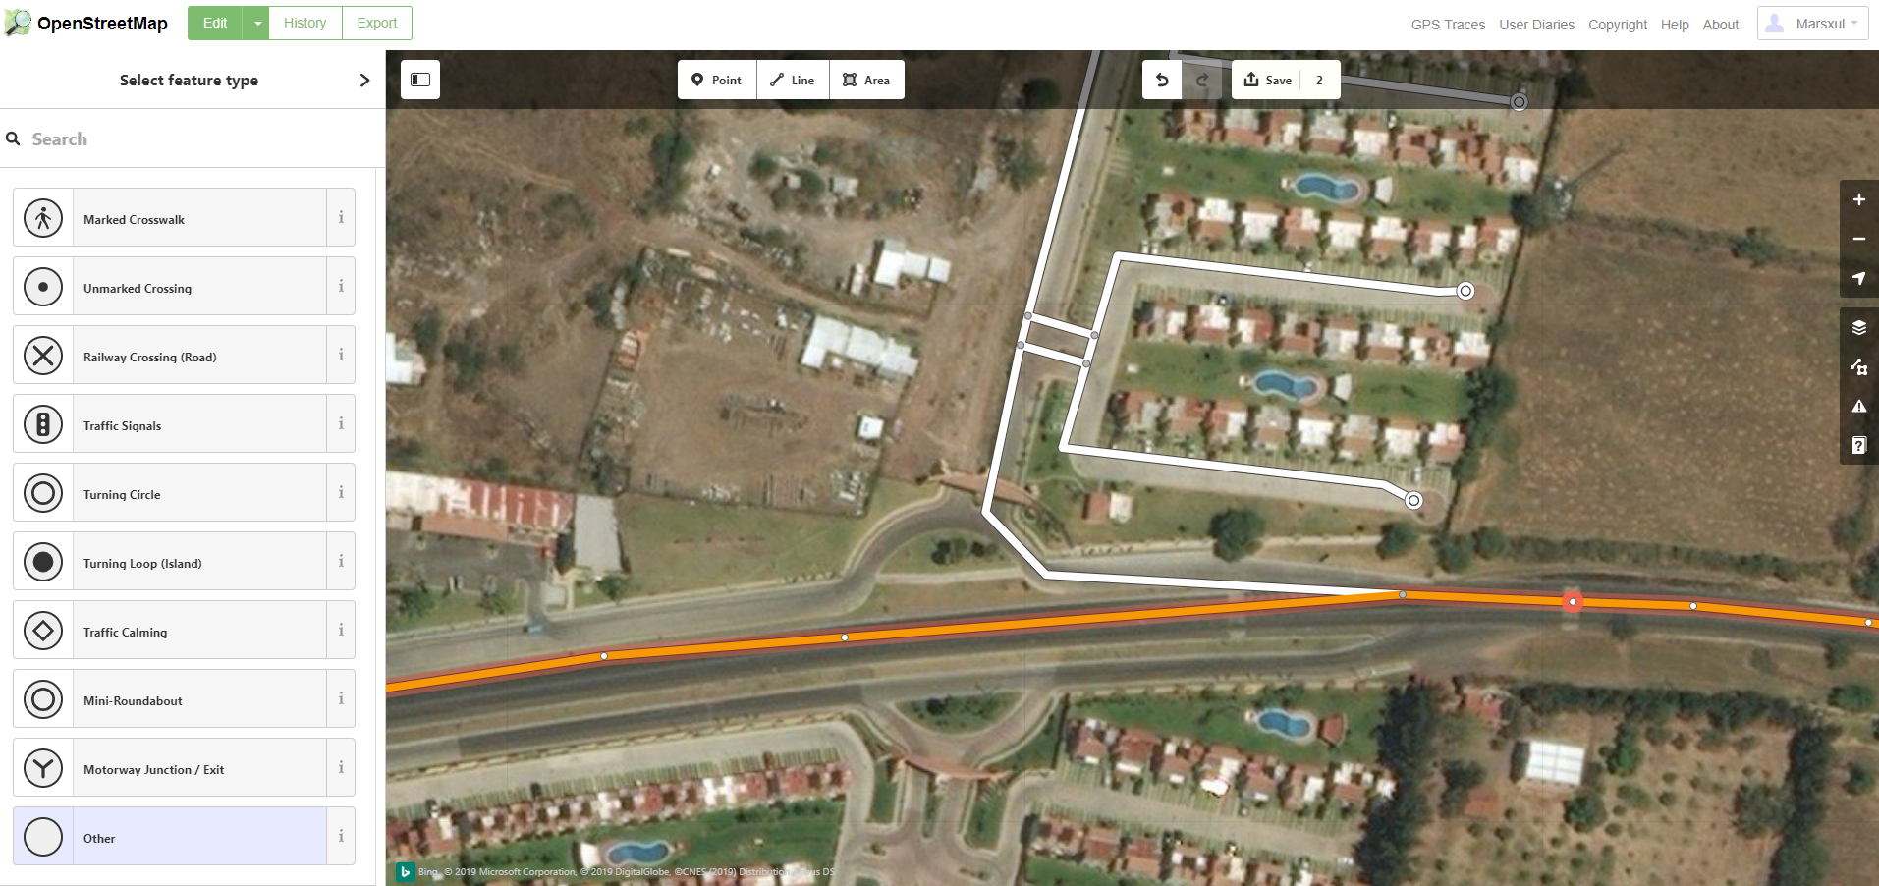
Adding Tag to Existing Highway at a Node

Slide 38
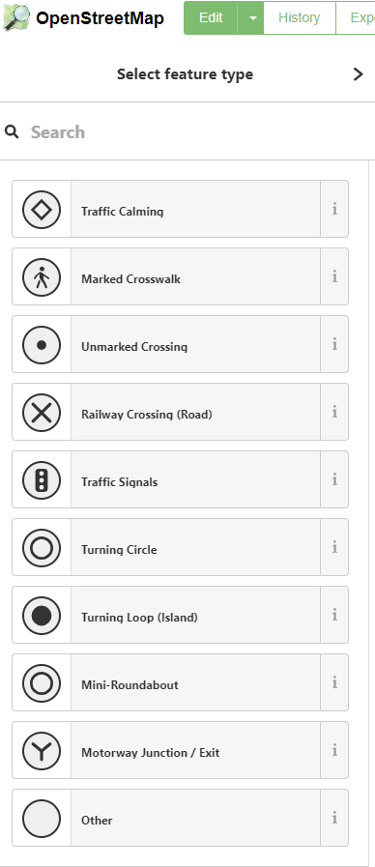
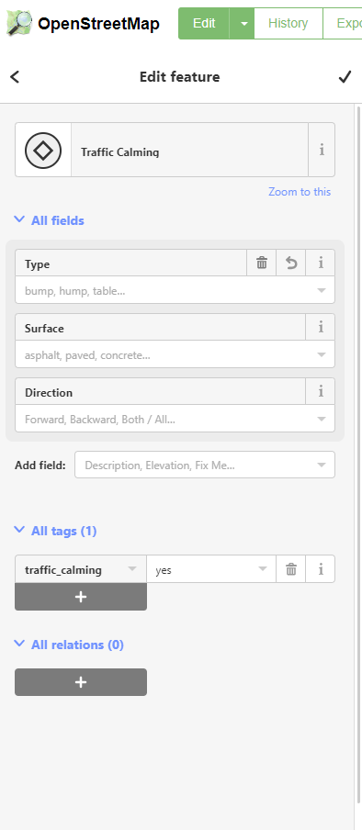
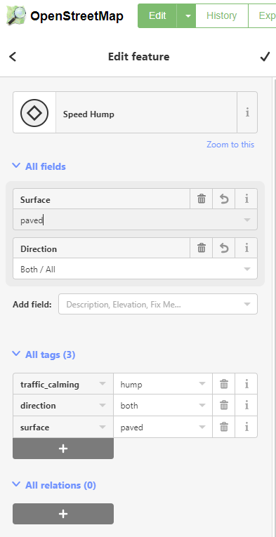
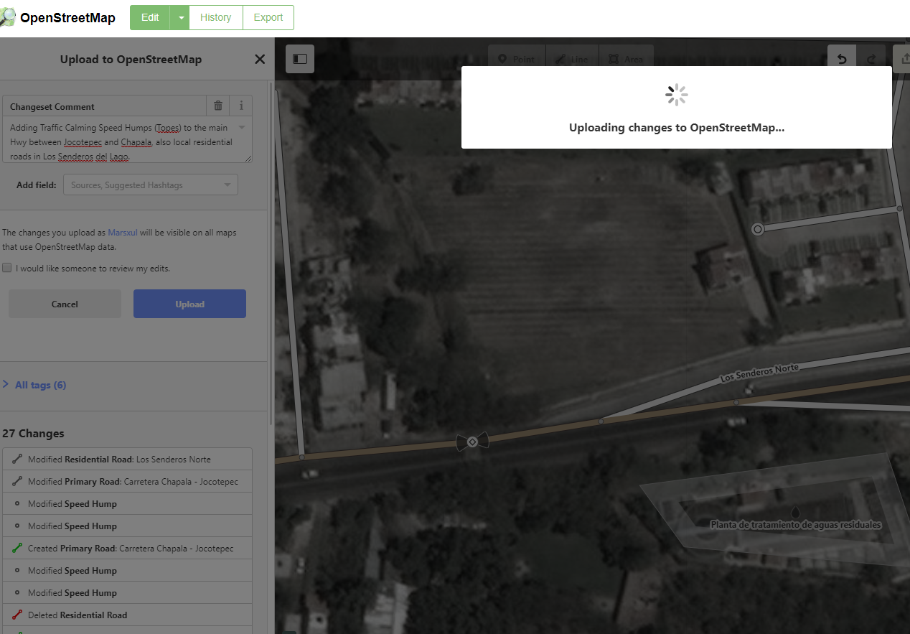

Slide 39
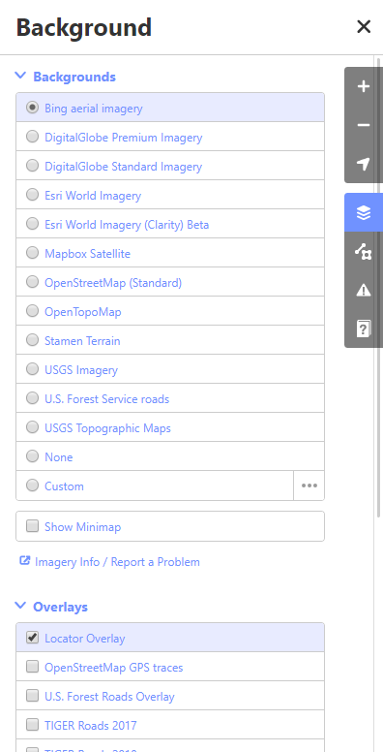
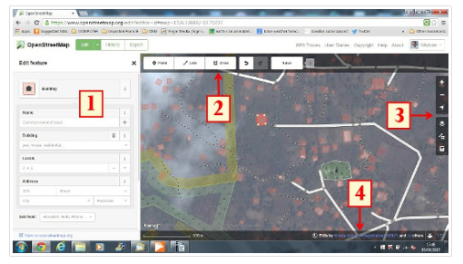
Editing with iD
A
C
T
I
V
I
T
Y
Select a location
Make edits
Add tags
https://learnosm.org/en/beginner/id-editor/

Slide 40
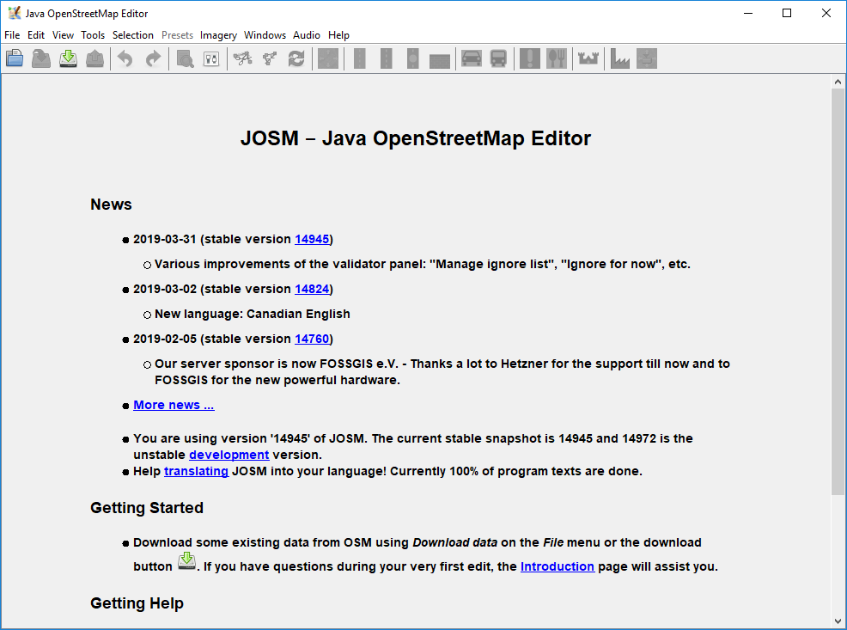
JOSM editor
https://josm.openstreetmap.de/
Awesome for bulk editing, locally stored and uploaded in a batch
Offline editing
Requires Java Runtime 8 update 201 – 4/7/2019

Slide 41
Editing with Software*
Java OpenStreetMap Editor (JOSM)
More or less the standard for editing in OSM
Edits offline
Edits are reconciled against the database
Versioning control
Can be run from web or installed
Style editor for the map display, including multiple styles
Connects to GPS

Slide 42

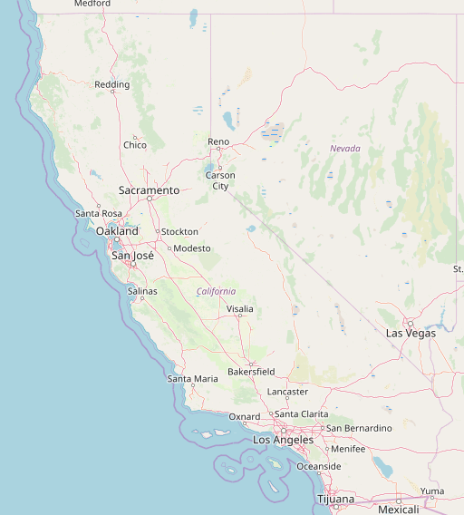
Common Uses Basemaps, API, Routing, Data Sources, Geocoding

Slide 43
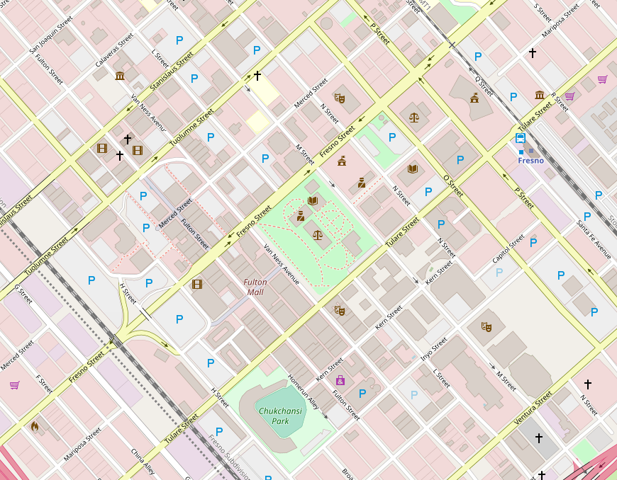
Basemaps
ArcGIS - https://www.arcgis.com/home/item.html?id=b834a68d7a484c5fb473d4ba90d35e71
QGIS – various plugins
Leaflet

Slide 44
Routing and Routing uses
Open Trip Planner - https://www.opentripplanner.org/
https://Trips.vta.org
https://modbeta.trimet.org/map/#/
Graphhopper
https://www.graphhopper.com/
Valhalla
http://valhalla.github.io/demos/routing/#loc=13,40.751000,-73.978300
Open Source Routing Machine - OSRM
http://project-osrm.org/
Open Route Service
https://openrouteservice.org/
And more

Slide 45
Geocoding
Nominatim – original geocoder from OSM
http://nominatim.org/
Pelias
https://pelias.io/
Limitations of geocoders
Address ranges
Point Addresses
Data Quality

Slide 46
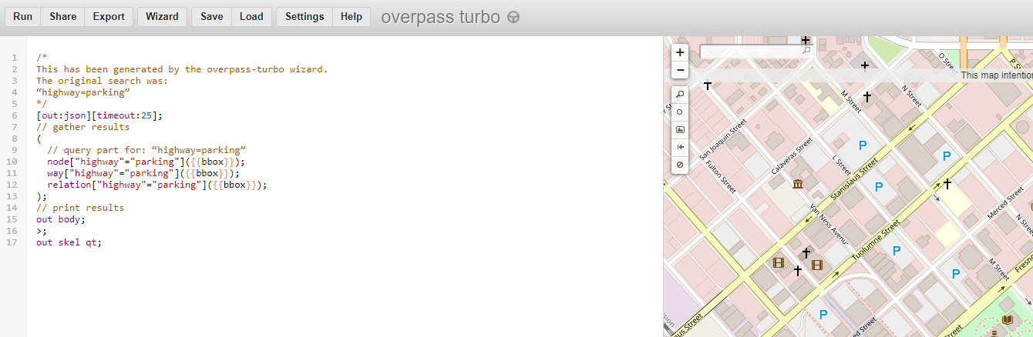
API’s, editing, downloads
Editing API – enable the editing tools
Downloading API - .pbf file
Small batches from main API primarily used by editing applications
Metro Extracts of OSM
https://metro-extracts.nextzen.org/
Overpass API
https://lz4.overpass-api.de/
Overpass Turbo
https://overpass-turbo.eu/

Slide 47
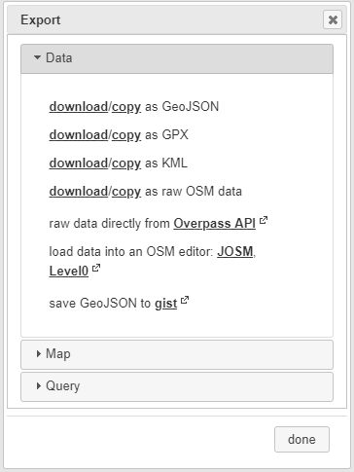
Data Source
A
C
T
I
V
I
T
Y
The Export
Overpass Turbo
How do you want your data?
Do you have a database for it?
Use tags to optimize your query
Try the wizard
parking=surface or parking=multi-storey

Slide 48
Apply to your preferred software and analysis
What do you want to do with your downloaded data
Inventories
Advanced Spatial Analysis
Level of Traffic Stress
What is the quality of the data?
Do you need at add data into OSM?

Slide 49
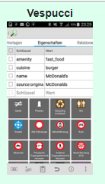
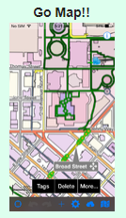

Walking and Mapping Time
A
C
T
I
V
I
T
Y
Let’s team up or download an app
Vespucci - http://vespucci.io/
Android
Go Map!! - https://wiki.openstreetmap.org/wiki/Go_Map!!
iOS only

Slide 50
Questions? / Preguntas?

